Slide 1



BUILDATHON
BUILDATHON 3.0
Track and question details
Team Name
Saumya C
Ayush J
Rohan V
Saurabh Y

Slide 2
PROBLEM STATEMENT
Problem Statement:
Despite the rapidly growing gig economy, tech and SaaS job markets, and increasing demand for internships, there is no comprehensive platform that seamlessly combines freelancing opportunities, job postings, and internships while enabling users to showcase their skills, connect with verified employers, and access meaningful career growth opportunities—all in one place.

Slide 3
OUR SOLUTION
Solution:
We are creating a platform where users can:
Earn through freelancing skills such as video editing, logo designing, web and app development, blog writing, and more, similar to Upwork.
Offer or apply for job opportunities.
Access or provide internship opportunities.
The platform empowers users to seamlessly apply for or offer jobs and internships, fostering a self-sustained ecosystem for career growth.

Slide 4
TARGETED SECTOR & AUDIENCE
Targeted Sector: Freelancing, internships, and jobs in tech, SaaS, and creative fields like video editing, web development, and graphic design etc.
Targeted Audience:
Students (18–25): Seeking internships and part-time jobs.
Freelancers (20–35): Skilled professionals looking for freelance gigs.
Job Seekers (21–35): Individuals pursuing tech and SaaS roles.
Employers: Startups and SMEs hiring for internships, freelance, or full-time positions.

Slide 5
MARKET RESEARCH
Market Research:
Freelancing: Global market expected to reach $12B by 2028, with 15M+ active freelancers in India.
Job Platforms: Online recruitment market valued at $30B, with platforms like Naukri and Internshala growing in India.
Tech Job Market: Global shortage of 4M tech professionals by 2025, particularly in India’s education sector.
Target Audience:
Students (18-25) seeking internships and entry-level jobs.
Freelancers (20-35) in creative/tech fields.
Startups/SMEs hiring talent.
Market Size:
15M+ freelancers, 500K+ tech graduates annually, 500K+ startups/SMEs in India.

Slide 6
PRODUCT FEATURES
Product Features
Job Search: Aggregates job listings from multiple platforms and government portals, offering a wide range of opportunities.
Freelance Gig Search: Dedicated section for discovering freelance opportunities across creative and tech industries.
Internship Search: Connects students with internship opportunities, helping them gain hands-on experience.
News Page: Provides real-time updates on the latest job, freelance, and internship offers, ensuring users never miss an opportunity.
Comprehensive Listings: Brings together job opportunities from multiple sources, including private platforms and government job portals.

Slide 7
TECHNICAL ARCHITECTURE
Technical Architecture
Current Application in Framer using CMS
Future Web App:
Frontend:
Web & Mobile (React, Flutter) for user interface
Real-time updates via WebSockets or Server-Sent Events
Backend:
Node.js/Express for API handling and business logic
Microservices architecture for scalability
Database:
Relational DB (PostgreSQL/MySQL) for user and job data
NoSQL (MongoDB) for dynamic content like job feeds and news
External Integrations:
REST APIs/Web Scraping for job listings from platforms like Naukri, LinkedIn, and government portals
News Aggregators (RSS Feeds/APIs)
Search:
ElasticSearch for efficient job, internship, and gig searches
Authentication & Security:
OAuth 2.0 & JWT for secure login
SSL/TLS encryption for secure data transmission
Hosting & Deployment:
Cloud (AWS, Google Cloud) for infrastructure
CI/CD pipelines for automated deployments
Analytics & Monitoring:
Google Analytics & Firebase for user tracking
Prometheus & Grafana for backend performance monitoring

Slide 8
FUTURE SCOPE
AI-Powered Job Matching: Personalized job recommendations based on user profiles and activities.
Skill Development: Online courses and certifications to enhance employability.
AI Chatbot Assistance: Real-time help with job searches, interview prep, and CV advice.
Freelancer Rating System: Ratings and reviews to build trust in the freelance marketplace.
Blockchain Verification: Secure job listings and user credentials to prevent fraud.
Global Expansion: Offer international job opportunities for Indian users and vice versa.
Networking Tools: In-app features for professional connections, messaging, and collaboration.
Mobile Enhancements: Push notifications for job listings, gigs, and news updates.
Educational & Corporate Partnerships: Collaborate with institutions and companies for internships and hiring opportunities.

Slide 9
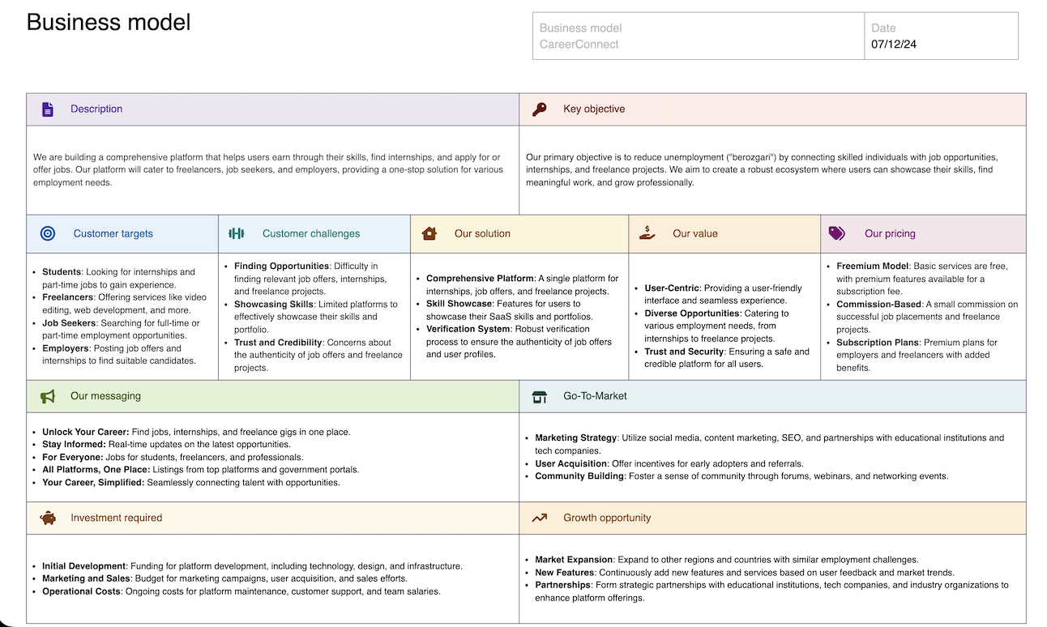
BUSINESS MODEL

